Slide 1
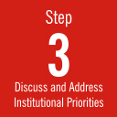
STAKEHOLDER ROUNDTABLE: Presentation Template
Ithaka S+R Sustainability Implementation Toolkit

Slide 2
Overview of Study
Findings
What faculty are doing today
What support looks like on campus
Institutional Approaches
Motivations
Organizational Models
Agenda

Slide 3
overview

Slide 4
To understand what support faculty and staff need to create and sustain digital research projects on campus.
To assess our current systems of support.
To clarify our motivations for supporting digital research projects.
To determine where there are gaps or overlaps in the current system, and what a better, more comprehensive system might look like.
Motivation for study

Slide 5
Interviews
Faculty survey
Key stakeholder roundtable
Our method

Slide 6
Findings
from our study

Slide 7
Group surveyed Includes:
FILL IN WITH FIGURES FROM YOUR SURVEY
[#] faculty in [#] departments sent questionnaire
[department 1] ([#])
[department 2] ([#])
[…]
Professors ([#])
Associate Professors ([#])
Assistant Professors ([#])
Other ([#])
[#] responses= [#]% response rate

Slide 8
What faculty are doing
today

Slide 9
[#]% of respondents use digital resources; most have used […]
FILL IN WITH FIGURES FROM YOUR SURVEY

Slide 10
About [#]% have created […]
FILL IN WITH FIGURES FROM YOUR SURVEY

Slide 11
Respondents intend for their resources to be available to the broader public…
FILL IN WITH FIGURES FROM YOUR SURVEY

Slide 12
…and to grow in the future
FILL IN WITH FIGURES FROM YOUR SURVEY

Slide 13
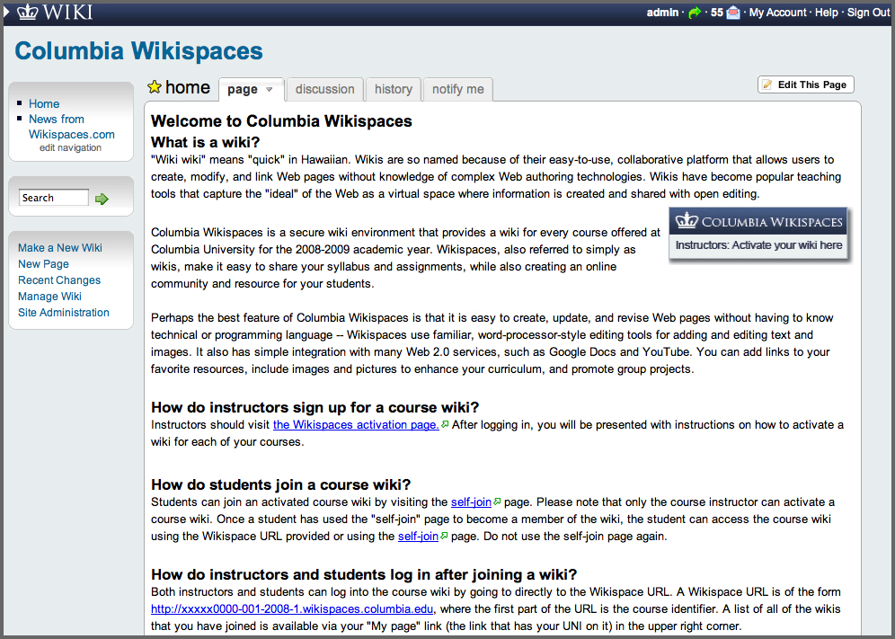
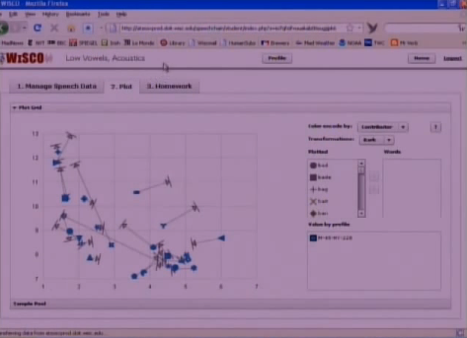
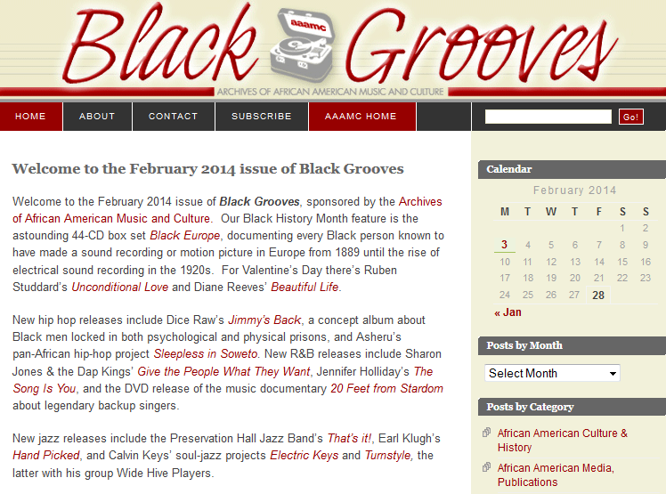
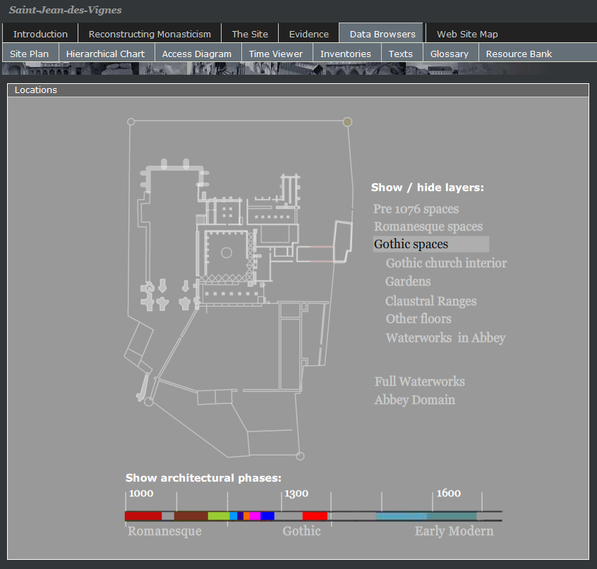
Examples of project types
COURSE WEBSITE
Columbia
WikiSpace
SOFTWARE/TOOL
Eric Raimy
WiSCO
CONTENT COLLECTION
(less complex)
Brenda Nelson-Strauss
Black Grooves
CONTENT COLLECTION
(more complex)
Sheila Bonde
Saint-Jean-des-Vignes:
Archaeology, Architecture and History

Slide 14
Lots of projects, but many are quite “basic”
FILL IN WITH FIGURES FROM YOUR SURVEY

Slide 15
What support looks like on campus
Responses for Campus-Hosted Resources (n = [#])
Fill in with figures from your survey

Slide 16
For upfront support, most respondents receive support from […]
FILL IN WITH FIGURES FROM YOUR SURVEY

Slide 17
[…] becomes increasingly important for ongoing support
FILL IN WITH FIGURES FROM YOUR SURVEY

Slide 18
Overlaps and gaps in support
FILL IN WITH FIGURES FROM YOUR SURVEY
 | Planning | Content creation | Technical development | Storage | Project mgmt. | Technical upkeep | Preservation | Dissemination
Library’s digital collections | 53% | 41% | 47% | 18% | 24% | 30% | 18% | 24%
Central IT | 29% | 6% | 24% | 47% | 12% | 41% | 35% | 0%
Instructional/ Acad. tech. | 6% | 6% | 6% | 0% | 6% | 6% | 6% | 0%
Academic dept./ inst. | 53% | 35% | 18% | 18% | 24% | 12% | 12% | 18%
Senior admin.’s office | 12% | 12% | 0% | 0% | 6% | 0% | 0% | 0%
N/A | 18% | 29% | 18% | 24% | 29% | 29% | 29% | 59%
overlaps
gap
Notes:
TIP: see our template for help in filling this out.

Slide 19
Almost [#] received support from [#] campus units/individuals
FILL IN WITH FIGURES FROM YOUR SURVEY

Slide 20
Faculty are most concerned about […] and […]
FILL IN WITH FIGURES FROM YOUR SURVEY

Slide 21
The concerns of FACULTY, in their voices
FILL IN WITH FIGURES FROM YOUR SURVEY
MONEY
There are internal and external funding resources for building new projects, but not much to sustain them over time.
Funding is oriented to creation, not maintenance.
Adequate funding is not provided to generate content, maintain infrastructure, and develop new technological methods.
We are dependent upon contributions from [DEPARTMENT] and the [UNIT], which have to be negotiated seemingly every year.
STAFF TIME
Digital Collections Services is very short of staff and resources.
I have no staff; I am learning as I go.
I need to be sure I have the time I need to upload new resources and to organize existing content.
Promises of institutional support/staff time changed between my application for outside funding and the awarding of my grants. Shifting institutional terrain made it seem unwise to count on IU for support, or to embed my project to much within its infrastructure, had it moved forward.
TECHNOLOGICAL CAPABILITIES
Open-source software is continually updated, and capabilities continually upgraded, so short shelf life requiring constant maintenance and upgrade.
There are not as many technology resources for [DEPARTMENT] compared to other fields.
Technology is not given enough funding to avoid immediate obsolescence.
Being up-to-date is vital, in order to have access to further financial resources (grants), but the opposite is also true: resources are necessary for keeping the project up-to-date.

Slide 22
Institutional approaches

Slide 23
What might drive a strategy of dh support?
Two possible mission-related aims
Experimentation, research
Focus is on providing basic tools and services to all; aim is to encourage unfettered experimentation and creation. No selection needed; value of the experience and learning, not on the need to support the outputs.
2. Curation, long-term stewardship
Focus is on supporting a select few projects to work on, curate, develop and support over time; aim is to capture the value of the intellectual capital created in these works to share with others. Selection based on value of content, compatibility with standard formats, and alignment with disciplinary strengths of the campus.

Slide 24
Motivation for support
Experimentation
Curation

Slide 25
Motivation for support
Experimentation
Tools for All
(“Philosophy of Abundance”)
Campus makes storage, access to platforms and tools available to all. Little coordination of outputs, once built.
Curation

Slide 26
Motivation for support
Experimentation
Tools for All
(“Philosophy of Abundance”)
Campus makes storage, access to platforms and tools available to all. Little coordination of outputs, once built.
“Collections” model
Support only for projects that agree to standard guidelines. Shared infrastructure supports discovery through central catalog.
Curation

Slide 27
Motivation for support
Experimentation
Tools for All
(“Philosophy of Abundance”)
Campus makes storage, access to platforms and tools available to all. Little coordination of outputs, once built.
Darwinian
Little guidance for faculty. Services only by special request. Little standardization. Most proactive and entrepreneurial PIs find sources of support; others don’t.
“Collections” model
Support only for projects that agree to standard guidelines. Shared infrastructure supports discovery through central catalog.
Curation

Slide 28
Motivation for support
Experimentation
Tools for All
(“Philosophy of Abundance”)
Campus makes storage, access to platforms and tools available to all. Little coordination of outputs, once built.
???
Baseline level of access to storage, tools for all. For those whose projects show need/potential for second stage development.
Darwinian
Little guidance for faculty. Services only by special request. Little standardization. Most proactive and entrepreneurial PIs find sources of support; others don’t.
“Collections” model
Support only for projects that agree to standard guidelines. Shared infrastructure supports discovery through central catalog.
Curation

Slide 29
Organizational models to consider
Service models (“Start Here” or Federated)
Centralized model, encouraging all to start at same point of reference, but referring PI s out to other units to benefit from local expertise, as needed. Coordination of standards, deposit and preservation of digital assets and metadata into one shared repository or catalog. Central “hub” could have strong coordinating role to support project planning, development capacity, preservation or other stages.
LAB
A largely autonomous, entrepreneurial unit, within or independent from the library, but with responsibility for generating a significant its own volume of self-sustaining work and financial support. May have some of the most experienced practitioners, but may be obliged to keep the focus on the select projects they choose to take on.
NETWORK
A highly decentralized model, aiming to have several different units work loosely together to support faculty. It may include a broad offer of basic technology access to all faculty. Beyond that, faculty can choose which units to appeal to for support.

Slide 30
Key elements of support
STAGES
PROJECT
PLANNING
CONTENT
CREATION
TECH
DEVELOPMENT
STORAGE &
PRESERVATION
DISSEMINATION (ACCESS, OUTREACH)

Slide 31
Key elements of support
STAGES
PROJECT
PLANNING
CONTENT
CREATION
TECH
DEVELOPMENT
STORAGE &
PRESERVATION
DISSEMINATION (ACCESS, OUTREACH)
MOTIVATION FOR SUPPORT
ACADEMIC RESEARCH
TEACHING
COLLECTIONS BUILDING, CURATION OF OUTPUTS
MAKING “PUBLIC”–IMPACT, DISSEMINATION

Slide 32
Key elements of support
STAGES
PROJECT
PLANNING
CONTENT
CREATION
TECH
DEVELOPMENT
STORAGE &
PRESERVATION
DISSEMINATION (ACCESS, OUTREACH)
MOTIVATION FOR SUPPORT
ACADEMIC RESEARCH
TEACHING
COLLECTIONS BUILDING, CURATION OF OUTPUTS
MAKING “PUBLIC”–IMPACT, DISSEMINATION
RESPONSIBILITY
LIBRARY
DEPARTMENTS
?

Slide 33
By demand (evidence of more projects)?
By financial measures (external, internal grants)?
By impact of the resources (audience, citations, etc. . .)?
By awareness?
Defining success of a support system

Slide 34
Other resources
Sustaining the digital humanities:
host institution support beyond the start-up phase
The full report is available at http://sr.ithaka.org/research-publications/sustaining-digital-humanities
SUSTAINABILITY IMPLEMENTATION TOOLKIT
The full components of the toolkit are available at
http://sr.ithaka.org/research-publications/sustainability-implementation-toolkit
The Ithaka S+R Sustainability Toolkit has been made possible in part by a major grant from the National Endowment for the Humanities: Exploring the human endeavor.

Slide 35
ITHAKA is a not-for-profit organization that helps the academic
community use digital technologies to preserve the scholarly record
and to advance research and teaching in sustainable ways.
JSTOR is a not-for-profit digital library of academic journals, books, and primary sources.
Ithaka S+R is a not-for-profit research and consulting service that helps academic, cultural, and publishing communities thrive in the digital environment.
Portico is a not-for-profit preservation service for digital publications, including electronic journals, books, and historical collections.
© 2014 ITHAKA CC BY-NC 4.0

